Slide 1

Welcome to ActiveNet
Click to Begin

Slide 2
Error!
Please follow the on-screen
instructions to continue.
Go Back

Slide 3
Complete
Please navigate to the next module
in the course to continue.
Restart Course

Slide 4
ActiveNet
ActiveNet is full of features to help us accomplish everyday tasks. From Course Registrations, Facility Reservations and Customer Organization to Lagoon Permits, Point of Sale Procedures and Sports Leagues, we use this imperative system in a meaningful manner.
Welcome to ActiveNet
Purpose of Trainer
This training system will guide you through common procedures when modifying accounts, taking registrations, processing POS transactions and reserving facilities. Upon successful completion of this course, you will gain access to our system and work with other staff to complete these tasks.
Next

Slide 5
“Before We Continue”
Each module within this course contains “Before We Continue” notes. These notes include the City of Carlsbad’s policies and procedures that relate directly on the module following.
Course
Instructions
Read to Understand
Be sure to read and understand the policies and procedures so you may answer the related questions on the module exam.
Discuss
Each module is named according to the material it covers. Please feel free to use the discussion board for help from your peers. Do not be afraid to ask your peers for assistance on topics you do not understand.
Back
Next

Slide 6
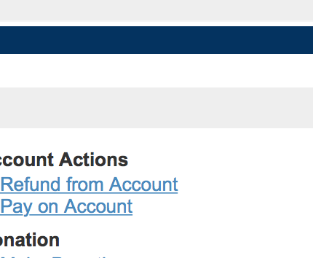
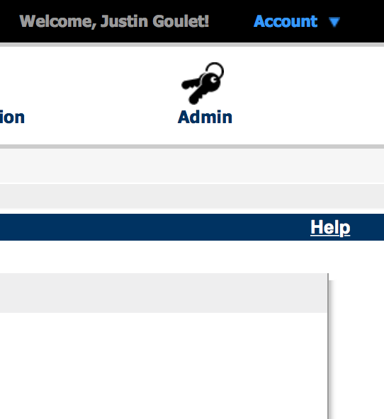
On ActiveNet, Blue means
ActiveNet
Tips
A “Help” menu appears on any page to provide you with instant help for the page you currently have open.
Back
Next

Slide 7
No Typing Needed!
For the sake of this course, you do not need to type any data into the text fields. Simply click the correct field and follow the on-screen instructions!
Bugs
If you come across a bug in the trainer, click the arrow on the webpage to advance to the next screen to send us related feedback.
Please note that you will still be tested on the related material!
Feedback Wanted!
We want to know your feedback! Whether there is a bug, an error in context or another topic you want us to cover, Let Us Know!
ActiveNet Trainer
Tips
Back
Next

